Slide 1
Post-processing For OCR Data
Use topic models to improve OCR (D1,C5)
Team group 2 members
Ghada Jerfel
Peilin Li
Xiaoyi Li
Hengyang Lin
Zhibo Zhou

Slide 2
PART. 01
PART. 03
Data Cleaning
Error Correction
contents
CONTENTS
PART. 02
PART.04
Error Detection
Performance

Slide 3
PART ONE

Slide 4
01
Data Cleaning Process
1
Loading data
2
Removing the punctuation and numbers
3
Comparing with ground-truth by rows
Delete the uneven lines.
Uneven: in our project means two lines don’t equal number of characters.

Slide 5
Error detection
PART TWO

Slide 6
02
Rule-based Techniques
Paper D1 Sectiom2.2
A string composed of more than 20 symbols is garbage.
If the number of punctuation characters in a string is greater than the number of alphanumeric
characters
Ignoring the first and last characters in a string, if there are two or more different punctuation characters in the string
If the first and last characters in a string are both lowercase and any other character is uppercase
If there are three or more identical characters in a row in a string
If the number of uppercase characters in a string is greater than the number of lowercase characters, and if the number of uppercase characters is less than the total number of characters in the string
If all the characters in a string are alphabetic, and if the number of consonants in the string is greater than 8 times the number of vowels in the string, or vice-versa,
If there are four or more consecutive vowels in the string or five or more consecutive consonants in the string, it is garbage

Slide 7
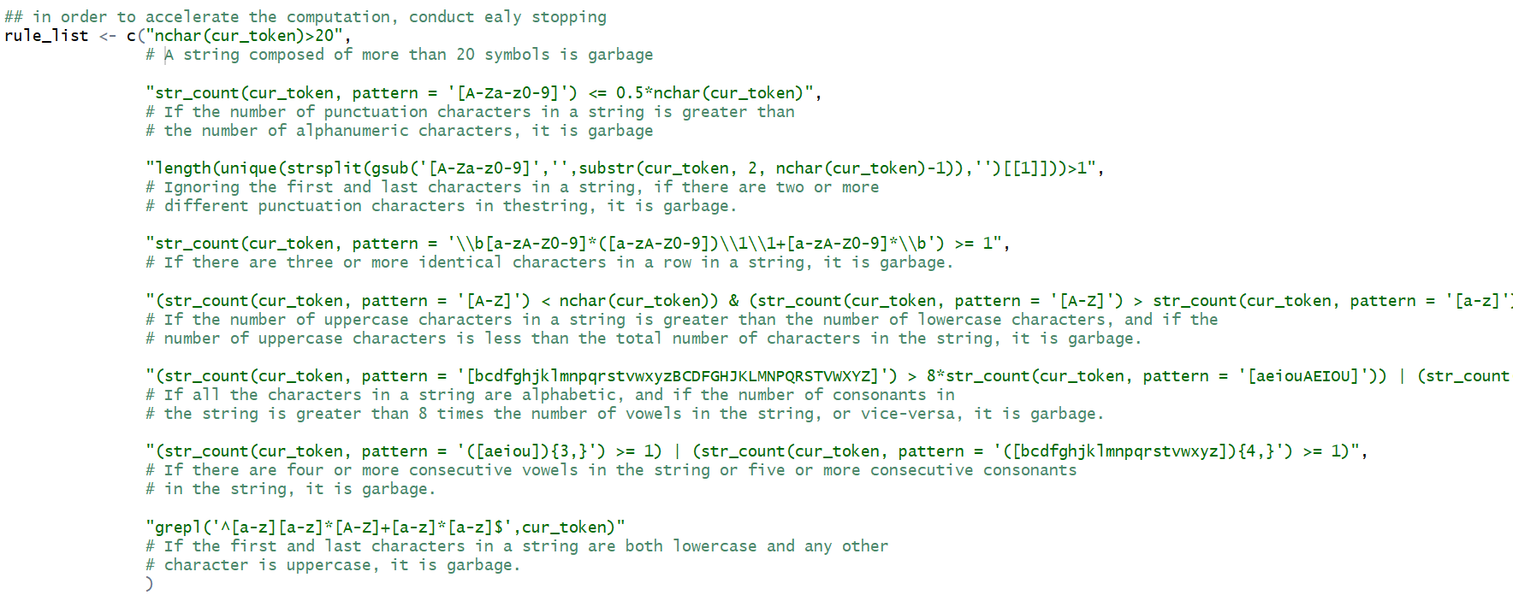
Code

Slide 8
Error Correction
PART THREE

Slide 9
03
Error Correction
Step 1
Propose candidates of correct word
Step 2
Compute a score for each candidate
Step 3
Pick the word with highest score

Slide 10
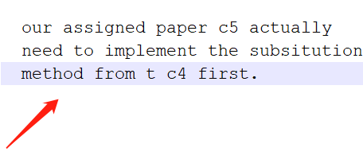
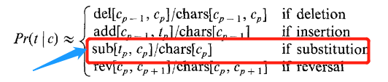
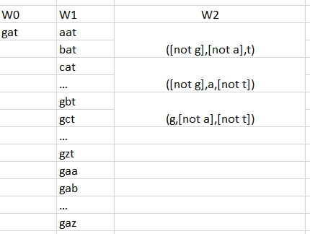
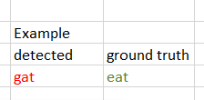
03
Step 1
Propose candidate of correct word

Slide 11
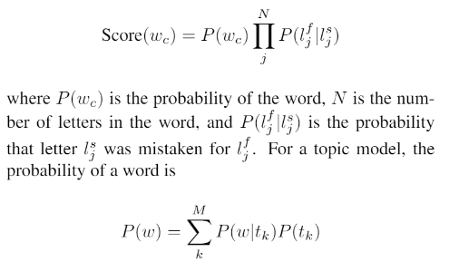
03
Step 2
Compute a score for each candidate

Slide 12

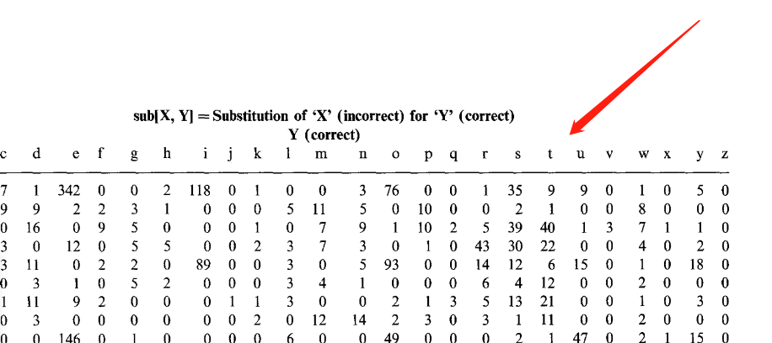
Continue
Confusion probability= p( g | e )*p( a | a )*p( t | t )
The confusion probability is come from the global confusion probability matrix in paper c4

Slide 13
Continue
P(w) = p(tonque | topic car)* p(topic car) + p(tonque | topic human)* p(topic human)
Typo(tonque)
torque
Topic car 80%
tongue
Topic human 20%

Slide 14
03
Step 3
Pick the words with highest score

Slide 15
PART FOUR
Performance

Slide 16
04
 | Tesseract |  | Tesseract_with_postprocessing
word_wise_recall |  | 0.5820031 | 0.6131548
word_wise_precision |  | 0.5731462 | 0.6374323
character_wise_recall |  | 0.7934582 | 0.8747239
character_wise_precision |  | 0.8073348 | 0.8936824

Slide 17
04
What’s Next ?
New candidates
Deletion
题文insertion字添
Uppercase letters and numbers

